Slide 1
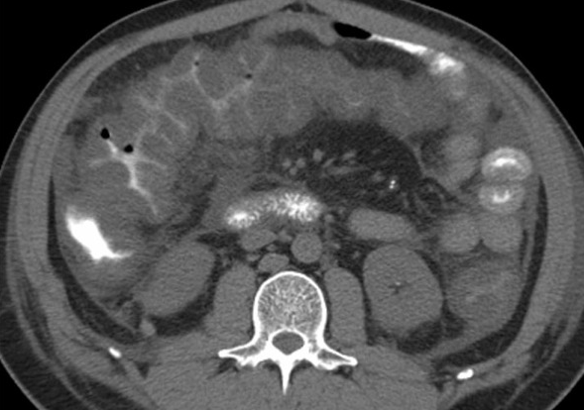
Clostridium Difficile Infection:
Treatments, Guidelines, and Challenges
Brian S. Zuckerbraun, MD, FACS
Henry T. Bahnson Professor of Surgery
University of Pittsburgh
Chief, Trauma and Acute Care Surgery
University of Pittsburgh Medical Center
Acting Chief, General Surgery, VA Pittsburgh Healthcare System

Slide 2
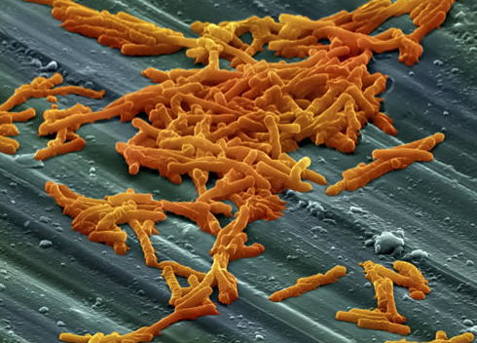
Background
-Clostridium difficile:
anaerobic,
gram positive,
spore forming,
bacillus
-Up to 3 million cases per year in US
-Estimated $3.2 billion/year in expenditures
-Mortality estimated to be ~4-8%

Slide 3
Pathophysiology
-C. difficile colonizes the colon after the normal gut microflora is disrupted by antibiotics or other host factors.
-Kyne et al demonstrated that 31% of patients who received antibiotics in the hospital were colonized with C. difficile and 56% of these developed symptomatic disease.

Slide 4
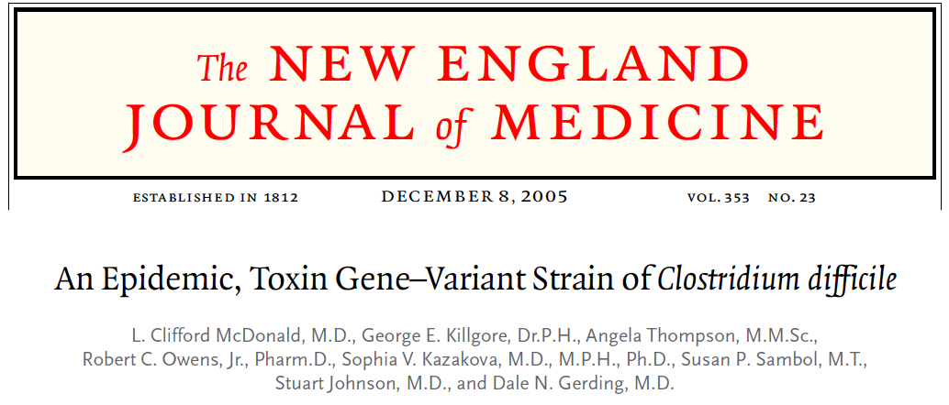
Pathophysiology
BI/NAP1/027: hypervirulent strain
-More than 60% of isolates at UPMC

Slide 5
Risk Factors
-Antibiotic use (fluoroquinolones, 2nd & 3rd generation
cephalosporins, clindamycin, & β-lactams)
-Hospitalization (20-40% patients colonized)
-Advanced age
-Immunosuppresion
-Antacids (PPI and H₂ blockers)
-GI surgery, IBD, NPO, elemental diets, NG tubes

Slide 6



Signs/Symptoms
-Diarrhea
-Abdominal Cramps/Pain
-Leukocytosis
-Fever
-Sepsis
-End organ failure

Slide 7
Issues
-Who to operate on? What are the indications for operative management? When to operate?
-What operation?
-What can we improve upon?

Slide 8


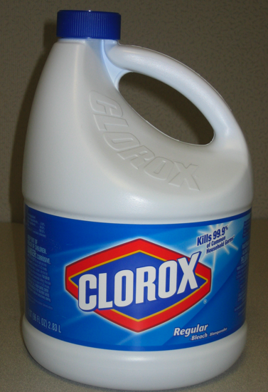
An ounce of prevention…..
-Infection Control
•Isolation precautions
•Handwashing
•Barrier precautions
•Cleaning with bleach
•Antibiotic stewardship

Slide 9
Severity Scoring and Treatment
Mild
diarrhea
Sepsis/
Extremis

Slide 10
Severity Scoring and Treatment
Mild
diarrhea
Sepsis/
Extremis

Slide 11
Severity Scoring and Treatment
Severity
Criteria
Mild or
Moderate:
Severe:
Severe,
Complicated:
WBC of 15K or lower &
Serum creatinine <1.5 times pre-morbid level
WBC of 15K or higher or
Serum creatinine >1.5 times the premorbid level
Hypotension or shock, ileus, megacolon
-SHEA and IDSA Clinical Practice Guidelines 2010

Slide 12
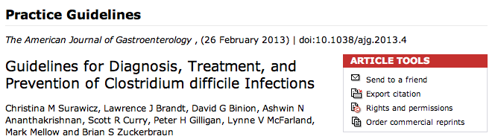

Slide 13
ACG Severity Scoring and Treatment
Severity
Criteria
Mild:
Moderate:
Severe:
Diarrhea
Diarrhea plus any additional signs or symptoms not meeting severe or complicated criteria
Any two of the following:
-WBC≥ 15000cells/mm³
-Serum albumin <3 g/dL
-Abdominal tenderness
Fujitani et al. Comparison of clinical severity score indices for Clostridium difficile infection. Infect Control Hosp Epidemiol. 2011

Slide 14
ACG Severity Scoring and Treatment
Severity
Criteria
Any one of the following:
-Admission to ICU for CDI
-Hypotension with or without required use of vasopressors
-End organ failure (Mechanical ventilation, Renal failure, etc)
-Mental status changes
-Fever ≥38.5°
-Ileus or significant abdominal distention/tender
-WBC≥ 35,000 cells/mm³
⁻Serum lactate levels greater than 2.2 mmol/Liter
Complicated:

Slide 15
ACG Severity Scoring and Treatment
Severity
Criteria
Treatment
Mild:
Moderate:
Severe:
Diarrhea
Metronidazole
500 mg PO tid
Diarrhea plus any additional signs or symptoms not meeting severe or complicated criteria
Any two of the following:
-WBC≥ 15000cells/mm³
-Serum albumin <3 g/dL
-Abdominal tenderness
Vancomycin
125mg PO qid

Slide 16
Metronidazole v. Vancomycin
Metronidazole
-effective as intravenous or enteral form
-Does not reach colon at effective MIC unless diarrhea
-Both dosing regimens dependent upon GI motility
Vancomycin
-Intravenous not effective
-Enteral (oral, tube, rectal) reaches colon at effective
MIC in both diarrheal and non-diarrheal stool
Notes:
NO ANTIBIOTIC CLEARLY BETTER. ONE STUDY SUGGESTS VANCOMYCIN BETTER FOR SEVERE DISEASE FOR INITIAL CURE. CONCERNS ABOUT INDUCING VRE WHEN USING VANC VERSUS METRONIDAZOLE ARE NOT FOUNDED. FIDAXOMICIN DOES NOT HAVE CLEAR ROLE. RECURRENCE LOWER OVERALL, BUT INITIAL CURE NOT BETTER. EXPENSIVE. STILL FINDING WORKABLE ROLE

Slide 17
Metronidazole v. Vancomycin
-No antimicrobial agent is clearly superior for the initial cure of C. difficile infection
-Three randomized control trials have compared metronidazole to vancomycin
*One trial demonstrated vanco superior in severe disease (Zar et al, Clinical Infectious Disease, 2007)
(evidence considered insufficient)
Notes:
NO ANTIBIOTIC CLEARLY BETTER. ONE STUDY SUGGESTS VANCOMYCIN BETTER FOR SEVERE DISEASE FOR INITIAL CURE. CONCERNS ABOUT INDUCING VRE WHEN USING VANC VERSUS METRONIDAZOLE ARE NOT FOUNDED. FIDAXOMICIN DOES NOT HAVE CLEAR ROLE. RECURRENCE LOWER OVERALL, BUT INITIAL CURE NOT BETTER. EXPENSIVE. STILL FINDING WORKABLE ROLE

Slide 18
Novel medical treatment strategies for Clostridium difficile infection
Antibiotics:
-Fidaxomicin (FDA approved)
-Rifaximin
-Nitazoxanide
-Teicoplanin
-Ramoplanin
Immunization therapy:
-Toxoid Vaccines
-Anti-Clostridium difficile toxin antibodies
-Intravenous immunoglobulin
Biotherapy:
-Fecal bacteriotherapy
-Non-toxigenic Clostridium difficile strains
-Probiotics
Notes:
NEW MEDICAL REGIMENS.

Slide 19
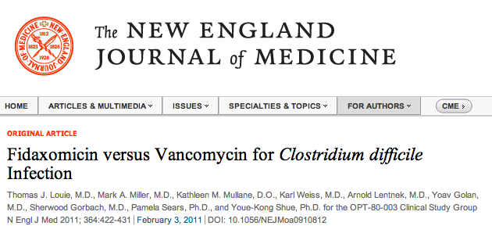
-Non-inferior to vancomycin for cure rate
-Lower recurrence rate compared to vanco
-expensive
-Use in setting of recurrences

Slide 20
Novel medical treatment strategies for Clostridium difficile infection
Antibiotics:
-Fidaxomicin (FDA approved)
-Rifaximin
-Nitazoxanide
-Teicoplanin
-Ramoplanin
Immunization therapy:
-Toxoid Vaccines
-Anti-Clostridium difficile toxin antibodies
-Intravenous immunoglobulin
Biotherapy:
-Fecal bacteriotherapy
-Non-toxigenic Clostridium difficile strains
-Probiotics
Notes:
NEW MEDICAL REGIMENS.

Slide 21
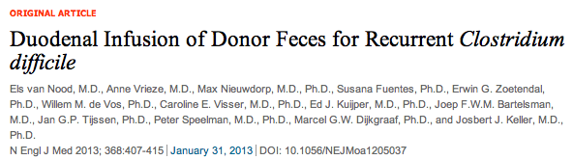

Slide 23
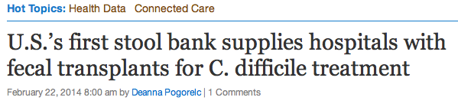



Slide 24
Recommended for recurrent disease
1st Recurrence: Vancomycin
2nd Recurrence: Vancomycin 7 week taper
3rd Recurrence: Fecal Microbiota Therapy

Slide 25
Severity Scoring and Treatment
Severity
Criteria
Treatment
Any one of the following:
-Admission to ICU for CDI
-Hypotension with or without required
use of vasopressors
-End organ failure (Mechanical
ventilation, Renal failure, etc)
-Mental status changes
-Fever ≥38.5°
-Ileus or significant abdominal
distention/tender
-WBC≥ 35,000 cells/mm³
⁻Serum lactate levels greater than 2.2 mmol/Liter
Complicated:
Metronidazole 500 mg IV tid
+
Vancomycin
125 mg PO qid
+
Vancomycin 500 mg in 500 mL saline as enema qid (if ileus or distended)
+
SURGICAL CONSULTATION

Slide 26
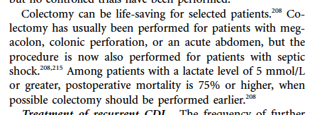
Severity Scoring and Treatment
Role for Surgical Treatment?
-SHEA and IDSA Clinical Practice Guidelines 2010

Slide 27
Surgery and CDAD
Colectomy associated with a 35-85% mortality.
Suggests:
-patients are sick
-magnitude of colectomy too significant
-we intervene too late

Slide 28

Surgery and CDAD
Dilemma
Operate early- near total colectomy + ileostomy is a large operation with significant short-term and long-term consequences.
Operate early- may end up operating on patients that would not need it.
Operate once patient sick: too late

Slide 29
Surgery and CDAD
Dilemma
Operate early- near total colectomy + ileostomy is a large operation with significant short-term and long-term consequences.
Operate early- may end up operating on patients that would not need it.
Operate once patient sick: too late

Slide 30
Severity Scoring and Treatment
Severity
Criteria
Treatment
Any one of the following:
-Admission to ICU for CDI
-Hypotension with or without required
use of vasopressors
-End organ failure (Mechanical
ventilation, Renal failure, etc)
-Mental status changes
-Fever ≥38.5°
-Ileus or significant abdominal
distention/tender
-WBC≥ 35,000 cells/mm³
⁻Serum lactate levels greater than 2.2
mmol/Liter
Complicated:
Metronidazole 500 mg IV tid
+
Vancomycin
125 mg PO qid
+
Vancomycin 500 mg in 500 mL saline as enema qid (if ileus or distended)
+
SURGICAL CONSULTATION

Slide 31
Surgery and CDAD
With the goal of decreasing mortality…
Lower the threshold for surgical consultation!
DO NOT THINK OF SURGICAL CONSULT AND
POSSIBLE SURGICAL MANAGAMENT AS
SALVAGE THERAPIES!!!

Slide 32
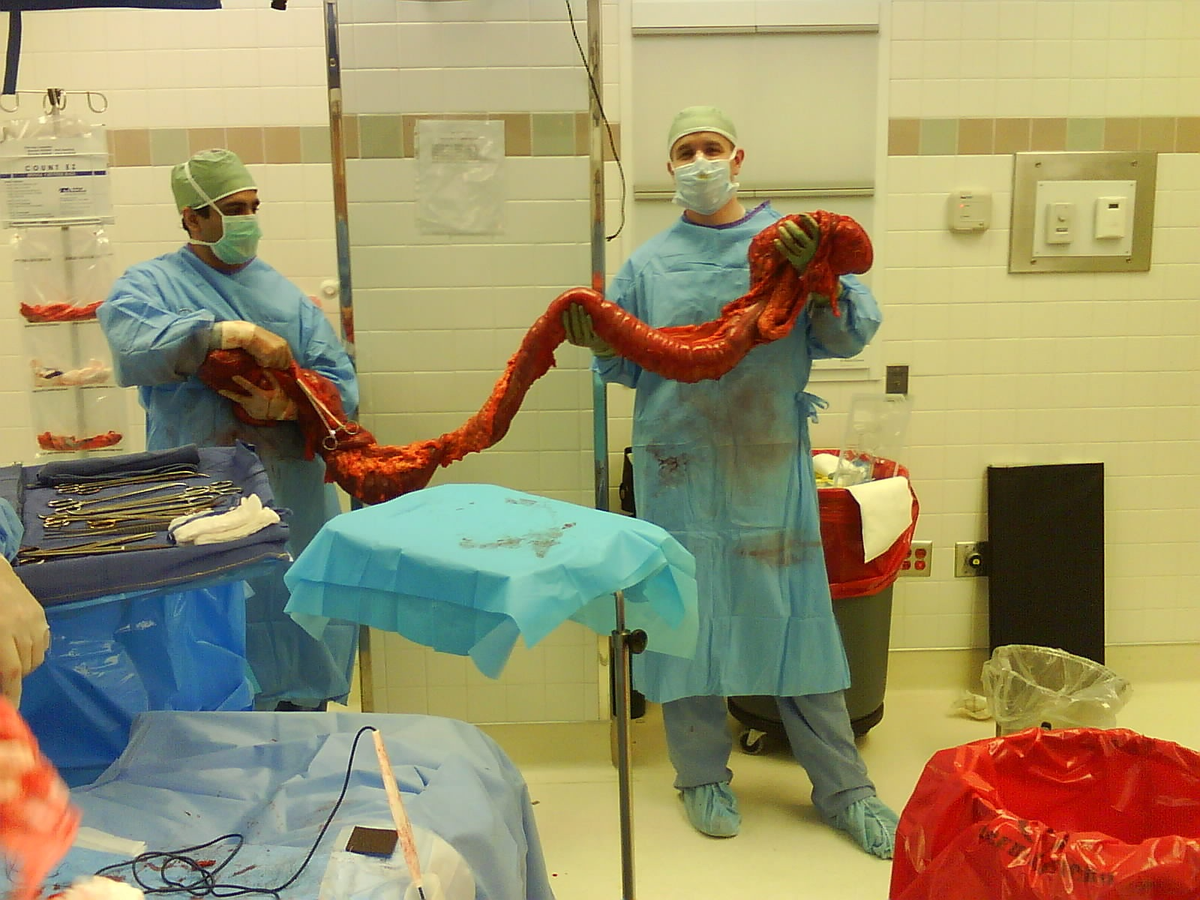

Slide 33
A diagnosis of CDAD as determined by one of the following:
1. Positive C Diff test
2. Endoscopic findings
3. CT scan consistent with CDAD
Plus any one of the following criteria:
1. Peritonitis
2. Perforation
3. Worsening abdominal distention/pain
4. Severe Sepsis
5. Intubation
6. Ongoing Vasopressor requirement
7. Mental status changes
8. Unexplained clinical deterioration
9. Renal Failure
10. Lactate > 5mmol/L
11. White blood cell count greater or equal to 50,000
Abdominal compartment syndrome
Not improving after ? days
Notes:
INDICATIONS FOR SURGICAL MANAGEMENT

Slide 34
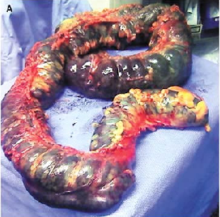
Not C Diff Colon

Slide 35
Is colectomy necessary for the treatment of
severe, complicated (fulminant) CDAD?

Slide 36
Hypothesis: Therapy to decrease bacterial counts and toxin levels throughout the whole colon will adequately treat severe, complicated CDAD.

Slide 37

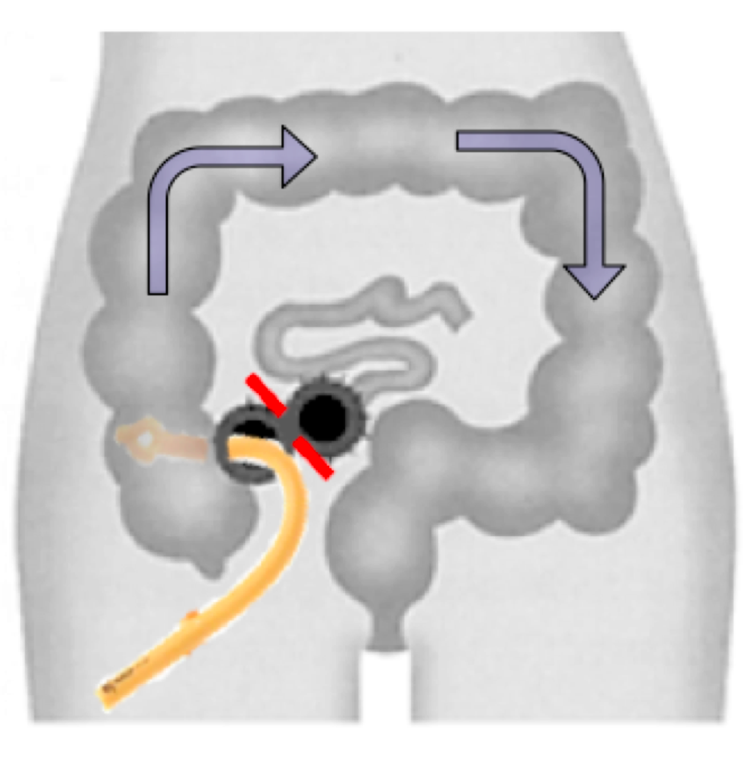
Methods
Exploratory laparoscopy/laparotomy
Creation of diverting loop ileostomy
Colonic lavage with 8 liters of warm PEG3350/balanced electrolyte solution (Go-Lightly™) via ileostomy
Post-op antegrade vancomycin flushes via ileostomy (500mg in 500ml tid) for 10 days

Slide 38
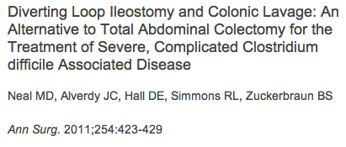

Slide 39
Loop ileostomy/colonic lavage v. total abdominal colectomy (historical controls) for severe, complicated C. Diff.
Ileostomy/washout
colectomy
APACHE-II (mean±S.D.) 29.7±10.8 29.9±8.9
Post-Operative Death 22/100* (22%) 49/100 (49%)
-3 patients not offered this therapy and offered colectomy
-7/100 had subsequent colectomy.

Slide 40
Loop ileostomy/colonic lavage v. total abdominal colectomy (historical controls) for severe, complicated C. Diff.
Ileostomy/washout
colectomy
Alive at 1 year 58/67 (87%) 36/51(71%)
Restoration of GI continuity 49/58 (84%) 8/36 (22%)

Slide 41
-Loop ileostomy and colonic lavage is an alternative to total abdominal colectomy for the treatment of severe, complicated C. Diff
-Improved survival in our series
-Colon preserved and many patients have had restoration of GI continuity

Slide 42
This approach may prove to be a better alternative to colectomy because:
-Colon is usually viable and can recover.
-Adequately treats the infection and resolves systemic symptoms.
-smaller insult

Slide 43
Loop ileostomy/colonic lavage v. total abdominal colectomy (historical controls) for severe, complicated C. Diff.
Ileostomy/washout
colectomy
APACHE-II (mean±S.D.) 29.7±10.8 29.9±8.9
Time from presentation to surgical consultation
11±9 hours
32±12 hours
?
Time from surgical consultation to operative intervention
7±6 hours
27±12 hours

Slide 44
Loop ileostomy/colonic lavage v. total abdominal colectomy (historical controls) for severe, complicated C. Diff.
Ileostomy/washout
colectomy
APACHE-II (mean±S.D.) 29.7±10.8 29.9±8.9
Time from presentation to surgical consultation
11±9 hours
32±12 hours
Time from surgical consultation to operative intervention
9±6 hours
29±12 hours

Slide 45
Loop ileostomy/colonic lavage v. total abdominal colectomy
-Is there a patient that is better off with TAC?
-Who is not a candidate for this operation?

Slide 46
Loop ileostomy/colonic lavage v. total abdominal colectomy
-Is there a patient that is better off with TAC?
-Who is not a candidate for this operation?
*Patients with colonic compromise.

Slide 47
Loop ileostomy/colonic lavage v. total abdominal colectomy
-Is there a patient that is better off with TAC?
-Who is not a candidate for this operation?
*Patients with colonic compromise.
*Abdominal compartment syndrome.

Slide 48
Loop ileostomy/colonic lavage v. total abdominal colectomy
-Is there a patient that is better off with TAC?
-Who is not a candidate for this operation?
*Patients with colonic compromise.
*Abdominal compartment syndrome.
*Patient population that has done the worse-
Patients with acute renal failure (anuric,
ongoing fluid resusc, requiring hemodialysis.

Slide 49
Loop ileostomy/colonic lavage v. total abdominal colectomy
-If they get loop ileostomy and don’t seem to be getting better, when do you take out the colon?
-What is the normal trajectory of improvement
*Patients that develop abdominal compartment
syndrome. We leave drain on everyone.
*Over 50% will plateau for about 5 days.

Slide 50
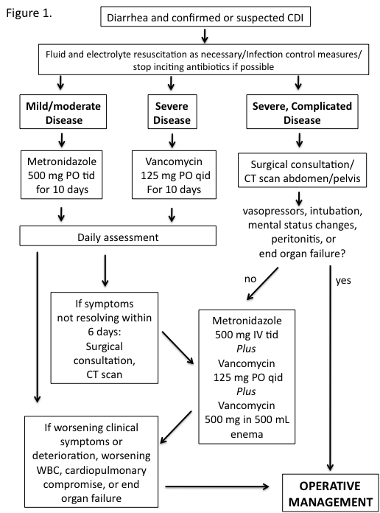
Notes:
MANAGEMENT SCHEMA

Slide 51
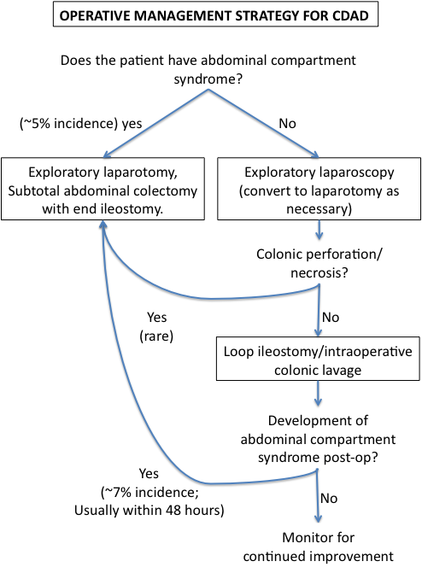
Notes:
OPERATIVE AND POST OPERATIVE MANAGEMENT SCHEMA

Slide 52


