Slide 1


The Year in Review:
Clinical Review
Rishi Rattan

Slide 2

Disclosures
None

Slide 3
Antifungals in upper GI perforations

Slide 4
Antifungals in upper GI perforations
Retrospective study of prospective single-center database
n = 107 (years 2008 – 2015), surgery for perforated peptic ulcer
25.2% (n = 27) received preoperative antifungal therapy
  85% fluconazole, 11% micafungin, 4% anidulafungin
51.5% of intraoperative fungal cultures (17 of 33) were positive
Antifungals: no effect on outcome, regardless of symptom duration
Positive culture: no effect on outcome
Retrospective with significant risk of bias, small sample size

Slide 5
Antifungals in upper GI perforations

Slide 6
Antifungals in upper GI perforations
Only two prospective RCTs (n=109, n=49), though more retrospective
SIS, IDSA currently recommend antifungals for upper GI
Area ripe for SIS-sponsored multicenter trial conducted by YOU!

Slide 7
24hrs of antibiotics for complicated appendicitis

Slide 8
24hrs of antibiotics for complicated appendicitis
SIS trial, STOP-IT (NEJM 2015): 4 days similar to longer course in IAI
JAMA Surg 2016 (van Rossem et al) prospective: 3 days noninferior to 5 days
Am Surg 2018 (Kimbrell et al) retrospective: 24hrs noninferior to >24hrs

Slide 9
24hrs of antibiotics for complicated appendicitis
Open-label, single-center, RCT (n=80, experimental n=39, control n=41)
82% (n=32) experimental protocol adherence (IV aminopenicillin x 24hrs)
Grades 2-4, i.e. gangrenous/perforated without diffuse peritonitis
Exclusion criteria included diabetes, immunodeficiency, chemotherapy
No difference in outcomes
  Mortality, infection, ileus, re-intervention, length of stay, readmission

Slide 10
24hrs of antibiotics for complicated appendicitis

Slide 11
24hrs of antibiotics for complicated appendicitis
No power calculation provided but almost certainly underpowered
Complication rate of 20% in intra-abdominal infection mirrors literature
  “It’s the nature of the disease, it’s not the nature of the antibiotic use.”
  Dr. Robert G. Sawyer
Area ripe for SIS-sponsored multicenter trial conducted by YOU!

Slide 12
Effect of OR attire policy

Slide 13
Effect of OR attire policy
2015 recommendations by Association for Perioperative Registered Nurses
  Non-cloth, disposable caps to cover ears, facial hair, nape of neck
  Arms always covered, no hand/wrist jewelry, no lanyards
  All personal items (phones, pens, etc) disinfected before entering OR
AORN J review (Spruce): “no conclusive evidence…covering prevents SSI”

Slide 14
Effect of OR attire policy
Before-after NSQIP study (n = 6,517) at 2 Eastern US teaching hospitals
  9 month before, 3 month transition period excluded, 9 months after
Complete coverage of all hair, facial hair, and ears using disposable protection
No hand/wrist jewelry on anyone in OR
Groups were not similar; post-implementation group:
  Older
  More steroids
Outcomes: surgical site infections, length of stay, complications, mortality
Subgroup analysis of clean + clean-contaminated cases only
More sepsis
Sicker
Lower BMI

Slide 15
Effect of OR attire policy
No difference in outcomes
Sample size to reduce SSI by 10%: 140,000 (NNT = 475)
JACS 2018 (Elmously et al): $540 million annually by US hospitals for jackets

Slide 16
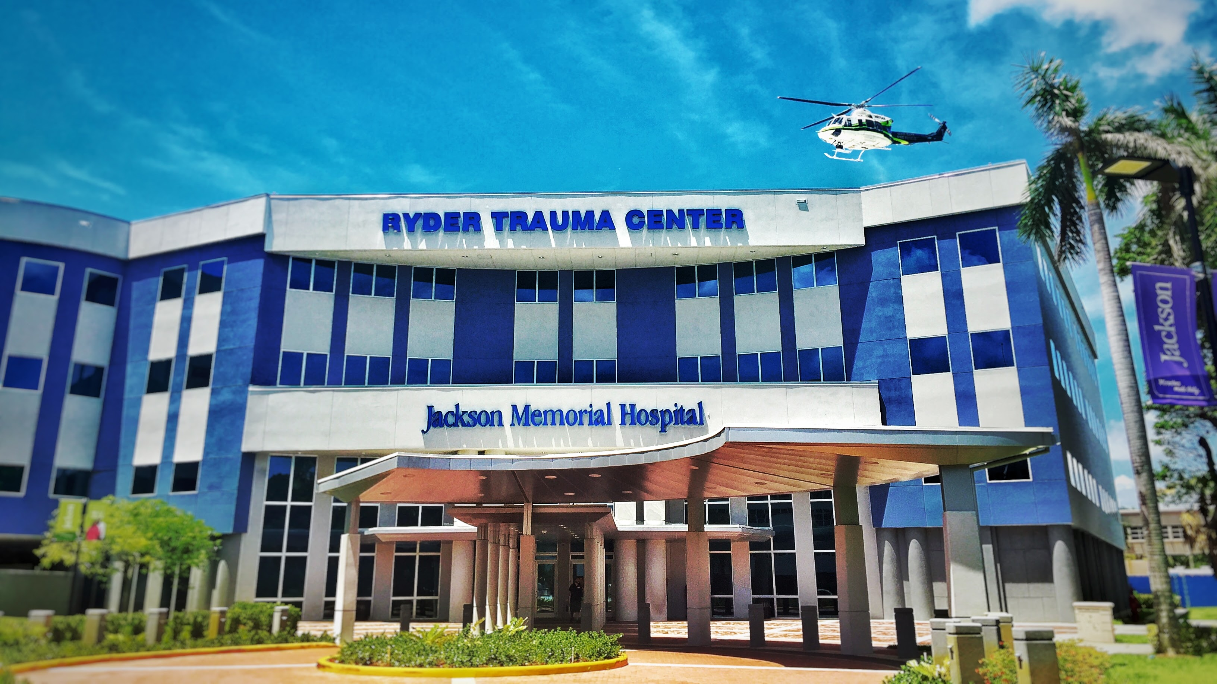
Thank you

